Slide 1


EN Virtual Symposium
Future-proofed assessment
Fabio Arico (University of East Anglia), Alvin Birdi (University of Bristol), Ralf Becker (University of Manchester), Jon Guest (Aston University), Mike Reynolds (University of Leeds), Robert Riegler (Aston University), Christian Spielmann (University of Bristol), Guglielmo Volpe (City University)

Slide 2
Breakout rooms
Programme-wide assessment
Online MCQs – possibilities and boundaries
There is no cheating, it’s all collaboration
Feedback to large numbers of students

Slide 3

Assessment changes for blended teaching
No traditional in person exams
Increase in use of coursework (essay, projects, presentations)
Timed online assessments – open-book?
Use of open-ended questions
More feedback?

Slide 4
Opportunities
To make assessment more authentic
To make assessment more inclusive
Use some technology to lessen assessment load

Slide 5
The challenges you have identified
What online timed assessments are possible (other than MC)
How to design inclusive assessment
Are there other creative assessment ideas
Assessing learning in an unsupervised environment
Setting reasonable exam questions

Slide 6
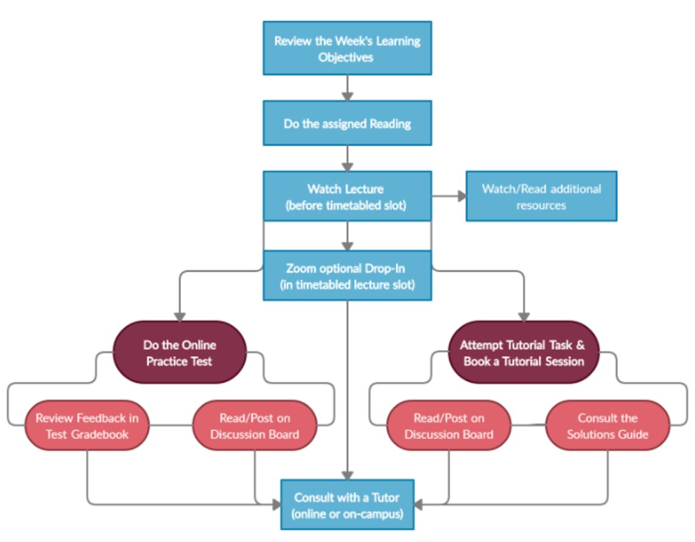
And there is another one... Alignment
Assessment?

Slide 7
Open book exams
Online or on-campus
Ralf Becker
The University of Manchester

Slide 8
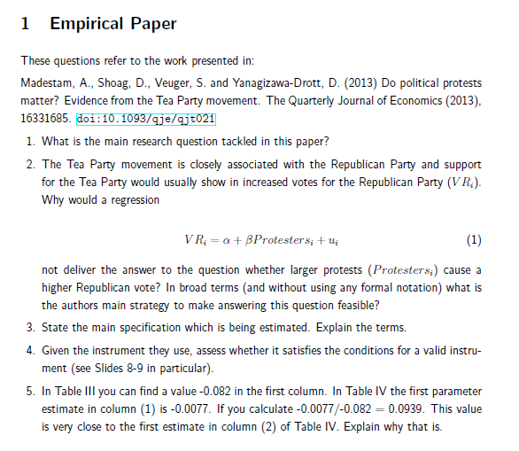
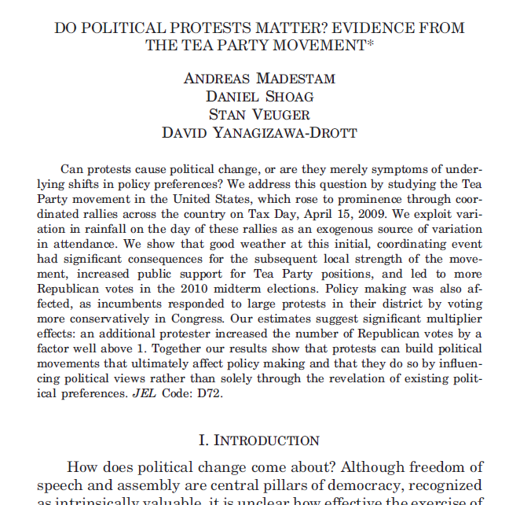
Context: 2nd year Quantitative Methods/Econometrics class,
focus on applied methods for causal inference, lots of empirical examples and R training
Aim: Use assessment to test whether students can interpret empirical work, identify
strategies, assumptions, strengths and weaknesses; interpret results
5 x Practical Demo Classes
Read:
+ some methodological questions

Slide 9
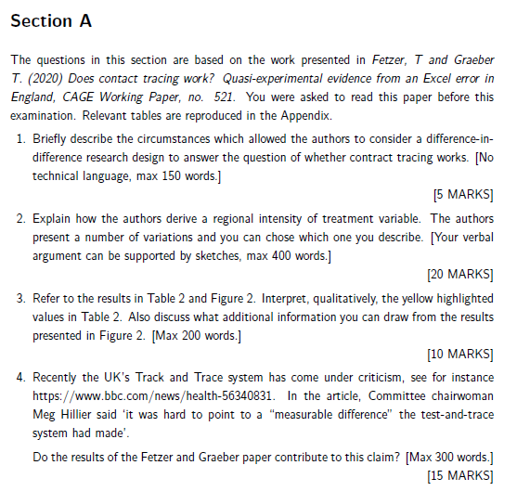
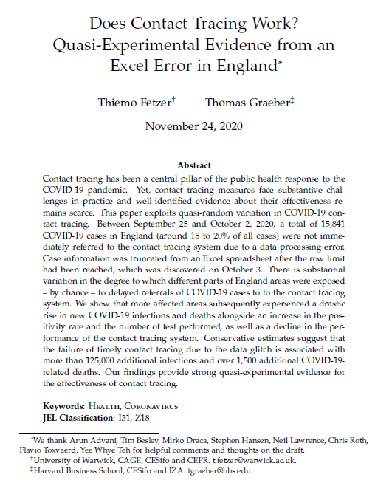
Exam - Online
48 h
Exam
Release
Exam
Submit
Several weeks
before the exam
Read:
+ some methodological questions

Slide 10
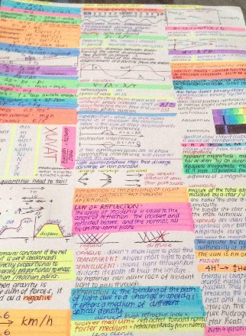
Exam – On-Campus
Several weeks
before the exam
Exam
Time
1.5 h
Read:
Bring Cheat sheet
* handwritten
* not photocopied
+ some methodological questions,
All relevant graphs and tables
included in exam paper

Slide 11
Take-away tips
Make tutorials/practicals mirror the exam structure (and call them practice exams)
Choose interesting papers
Challenging questions need to lead outside the paper (link to other papers or ask to use the results to comment on things which were not covered in paper)

Slide 12

Viva Voce Assessment
Fabio R Aricò – University of East Anglia
@FabiOArico

Slide 13
Evaluative Conversations: viva voce assessment
Why? viva voce assessments are under-utilised at UG level
it can develop useful skills for students → job interviews
it is not subject to any risk of plagiarism in an open-book world.
How? set time-slots and allow students to book themselves online
conversation 15-20mins + 10 mins to edit feedback
recordings allow to maintain quality assurance and enrich feedback
easily implemented either online or face to face.
Benefits personalised assessment experience → connect with students
can be linked to other assessments (e.g. follow-up on written piece).
Contact F.Arico@uea.ac.uk @FabioArico

Slide 14
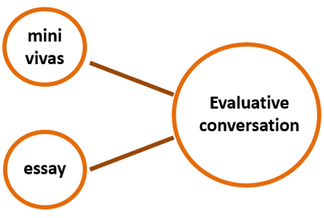
Assessment Design in HET module
SKILLS
KNOWLEDGE

Slide 15
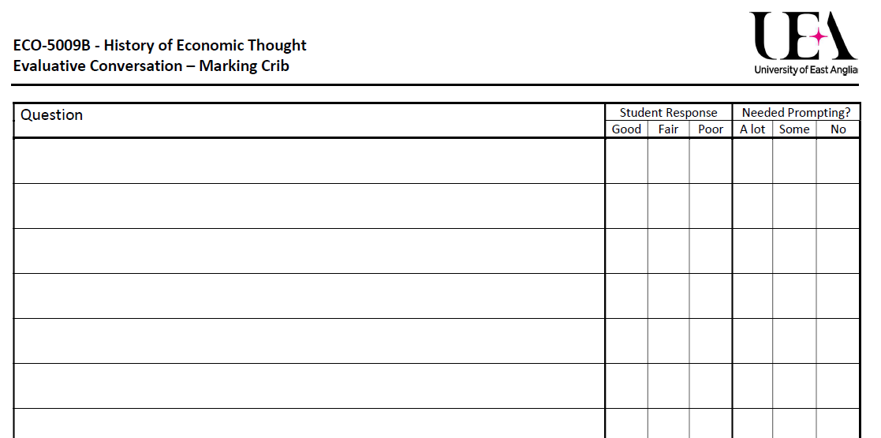
Assessment Tools: marking crib

Slide 16
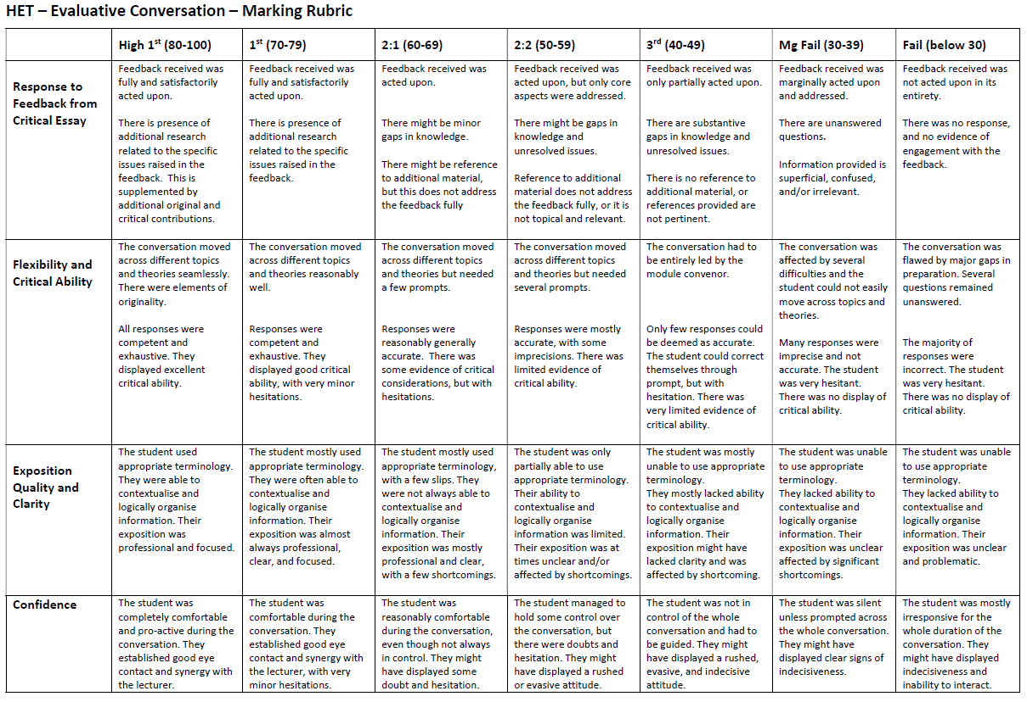
Assessment Tools: marking rubric

Slide 17
Breakout rooms
Programme-wide assessment
Online MCQs – possibilities and boundaries
There is no cheating, it’s all collaboration
Feedback to large numbers of students

