Slide 1

Carlos Cortinhas
c.cortinhas@exeter.ac.uk
Group work in an Economics Degree?
You must be mad!

Slide 2

Introduction
The move to blended/online learning is creating enormous challenges in terms teaching (among many other things):
A particular area of concern for me is: How we can ensure a sense of community and provide a good student experience in cohorts that are not meeting face-to-face?
We know that completion rates on MOOCs are extremely low (most tend to be less than 5%) – one of the reasons (arguably) is the sense of isolation and lack of a sense of community among participants.
I have decided to introduce a summative Group Work task to try and address some of those challenges…

Slide 3
Group Work in Economics?
I must be mad!
I, like many other economic academics never really considered doing this before :
My class sizes tend to be quite large (350+) and I am the only lecturer with just one or two TAs to help with the tutorials so lack of resources is an issue.
I am also well aware of all the usual challenges that Group Work brings (increased email traffic, need for conflict resolution, free-riding, etc, etc).
Why do it then? Because of the move to blended learning! Group work should help create a sense of community among group members and help them develop important skills. Without it I fear students will be less engaged with the module.

Slide 4

Why Group Work?
Engaging in group work offers a wide range of benefits, including (not exclusive list):
It enhances learning as it enables a variety of ideas to be discussed and encourages active learning.
Enables students to develop a range of interpersonal (and employability) skills including communication, negotiation and leadership.
Working collaboratively with both staff and students allows students to actively engage with current research.
It promotes the sharing of ideas and problem-solving skills, as some students might feel less intimidated and more willing to discuss work with their peers.

Slide 5

Prepare, prepare, prepare! Some tips
Most of the literature on Group Work emphasizes the need for the academic to prepare this task very well (and in much detail) and try and anticipate issues that may arise:
Anything that is ambiguous will create work later on – try and be as specific and complete as possible (I have attached an example of an Group Work Assignment Brief).
I decided to make Group Work summative (20% of final mark) as otherwise some students will have little incentive to take part.
I will decide on the group composition and use the same groups in the tutorials (i.e. breakout rooms in Zoom and/or face-to-face) – this will ensure students get to know each other well before they have to work together!

Slide 6
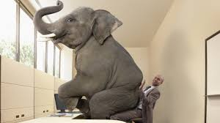

Dealing with the elephant in the room: Free- riding
Free-riding is one the most serious problems with Group Work and if not addressed it will create a large amount of conflicts and student dissatisfaction.
My starting principle is that students should be awarded a grade according to their effort and the quality of their individual work not just the end product. So it is important to ensure students do not all get the same mark automatically…
To address this it is crucial to understand the difference between “Product” and “Process”
  “Product” is the submitted assignment and the grade awarded for this component must be the same for all group members
  “Process” refers to how each individual student contributed to the common task and measures whether (and how) each students met the ILOs relating to participating meaningfully in the common task.

Slide 7
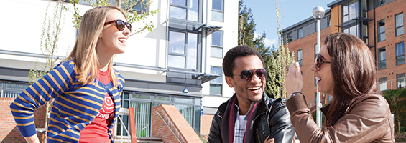
Product vs Process
Distinguishing between Product and Process allows for the allocation of different grades to each student according to how each met the ILOs thus rewarding effort and avoiding Free-riding (I hope)
In my case, I decided that the individual mark of each student is arrived at in this way:
Group component (worth 80%) = Evaluates the Product (in my case, this is 1 Excel file + 1 word document that the group needs to produce)
Individual component (worth 20%) = Evaluates the Process (in my case, an Individual Learning Journal)
It is crucial that students and staff clearly understand how each of these components will be evaluated – remember ambiguity creates conflict!
The way to do this is to create very detailed marking grids (and assignment briefs) for each component:

Slide 8
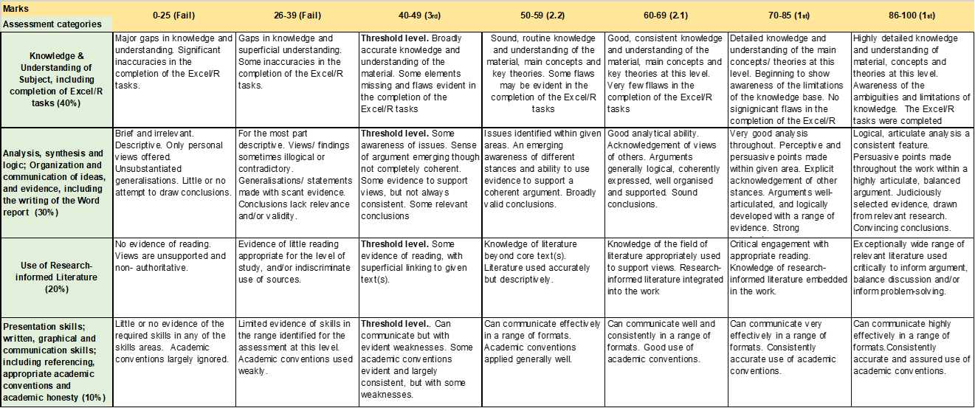
Assessing the Group component (80%)

Slide 9
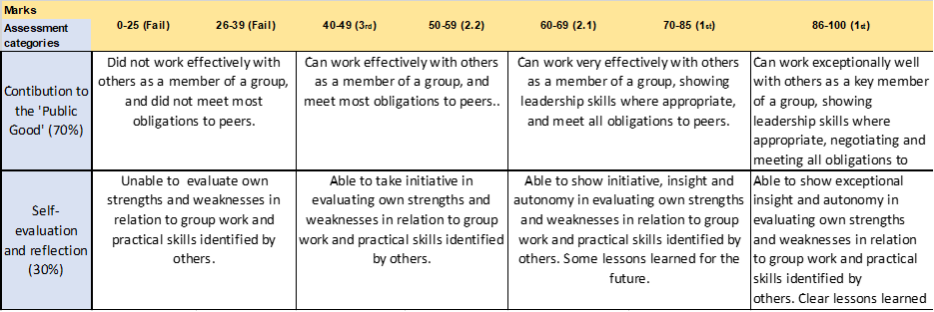
Assessing the Individual Component (20%)

Slide 10
Literature on Group Work
A good starting point might be the chapter on Group Work and Assessment (although it is a bit old) in the Handbook for Economic Lecturers of the Economics Network:
https://economicsnetwork.ac.uk/handbook/groupwork/

Slide 11

Final remarks
This presentation describes my personal view on how Group Work should be structured
This does not, therefore, comprehensively describe everything about this topic. There are many other ways, for example, to deal with Free-Riding like using peer-marking, vivas, etc.
I have the expectation that not everything will work well the first time around and that incremental improvements will be needed in future years – I will explain this to students and ask them to understand this is a worthwhile journey.
Despite the many challenges and additional workload, I believe it will be worth doing – With Covid, we all have to work on finding ways to develop a class identity and provide students with a good student experience – otherwise many will drop out or not accept to pay the fees – ultimately our jobs depend on this!

Slide 12
Thank you!
Questions and/or comments welcome:
c.cortinhas@exeter.ac.uk

