Slide 1
Open versus structured research environment in undergraduate Economics: A Case Study
Emanuela Lotti (University of Southampton) and Dafni Papoutsaki (University of Sheffield)
DEE Conference 2017 - UCL - London

Slide 2
UG Dissertation
The UG Dissertation encourages students to become independent learners and provides opportunities to learn in depth about a particular topic
Qualitative comments of module evaluations suggested that the dissertation is a very demanding task for an undergraduate student
In many UG programmes, the dissertation is an important component of the degree which may be compulsory for all students or may be offered to a selected group (see Peter Smith, 2009)

Slide 3
UG Dissertation
In 2015/16 the Department of Economics introduced changes aimed at a more structured research
  Introduction of `more’ specific research topics
  Earlier on dissertation allocation
  Increase in weights of one summative component
  Surgeries in addition to one-to-one supervision
What is the impact of the changes on student experience and on their performance?

Slide 4
Module Evaluations

Slide 5
Evaluation
We compare second year average mark with dissertation mark for the treatment group (students graduating in July 16)
We choose students graduating in July 2015 as control group
We focus on two programmes to avoid selection issues (students on those programmes have to do an Econ dissertation)
We compare the means and we do quantile regression

Slide 6
Literature Review
Bandiera et al. (2015)
  Blissful ignorance? A natural experiment on the effect of feedback on students' performance
Angrist et al. (2009)
  Incentives and Services for College Achievement: Evidence from a Randomized Trial
Azmat and Iriberri (2010)
  The importance of relative performance feedback information: Evidence from a
  natural experiment using high school students

Slide 7
Descriptive

Slide 9
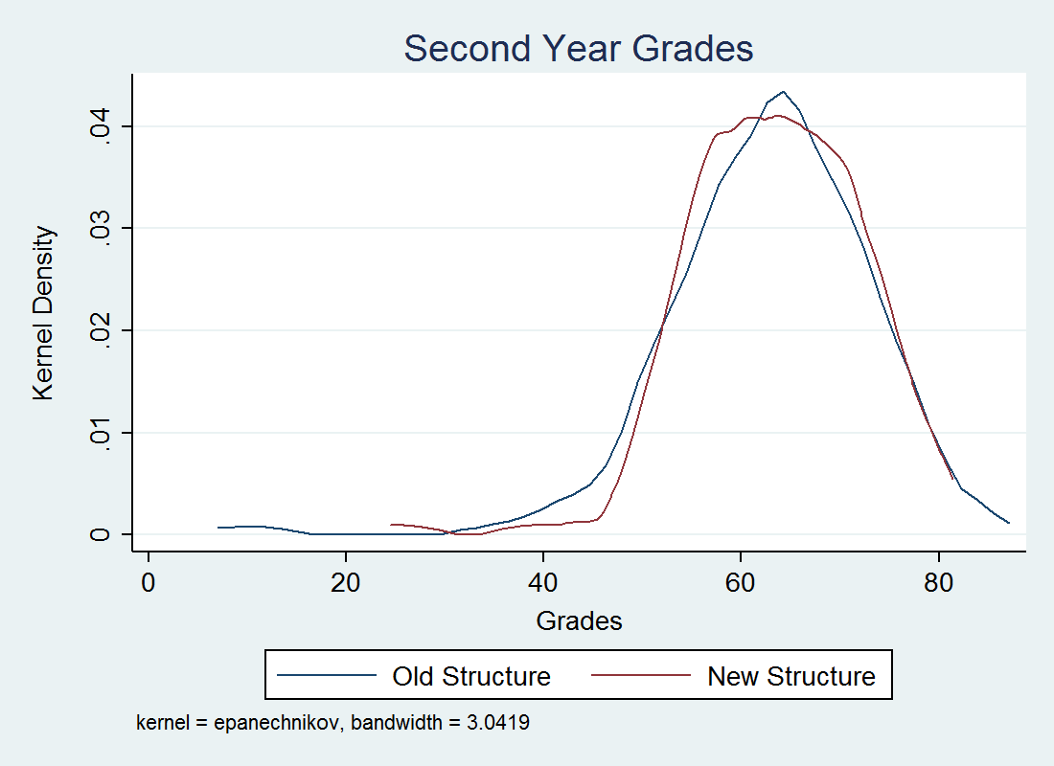
Kernel Density estimates of students performance in year 2

Slide 10
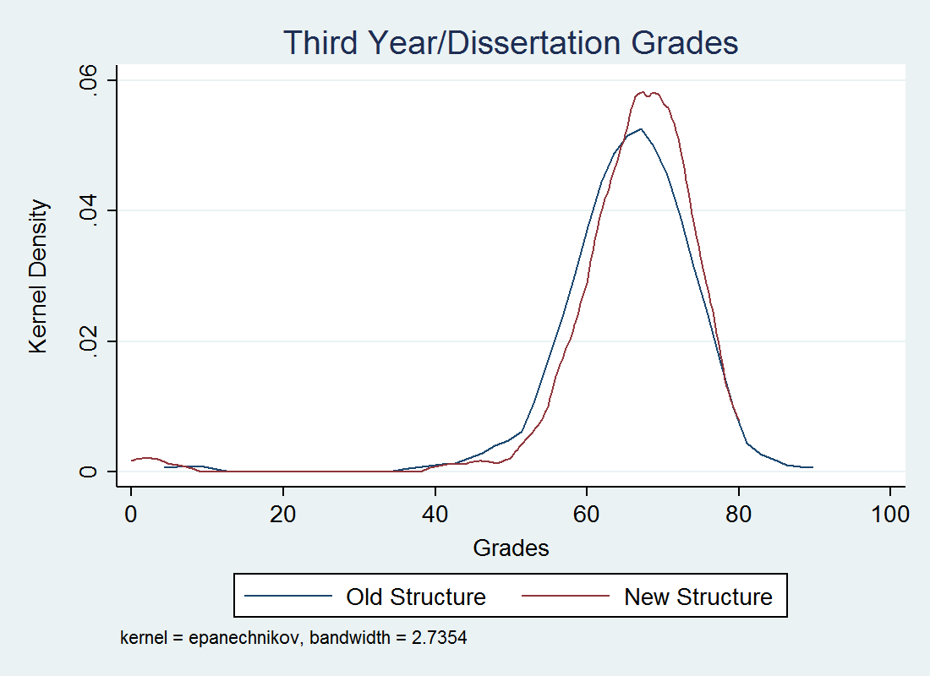
Kernel Density estimates of students performance – dissertation mark

Slide 11
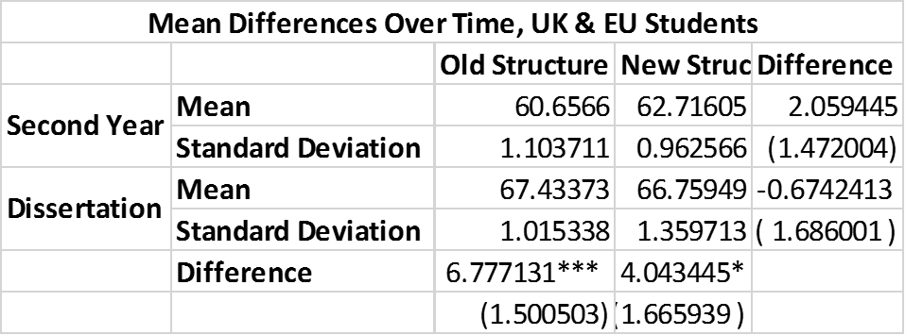
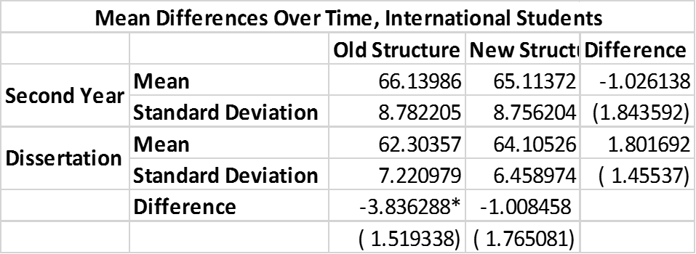

Slide 12
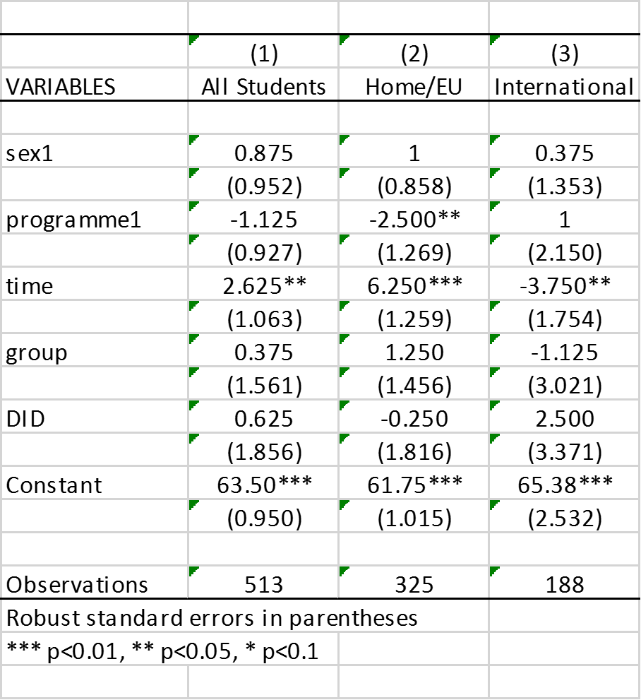
Median

Slide 13
75th percentile

Slide 14
25th percentile

Slide 15
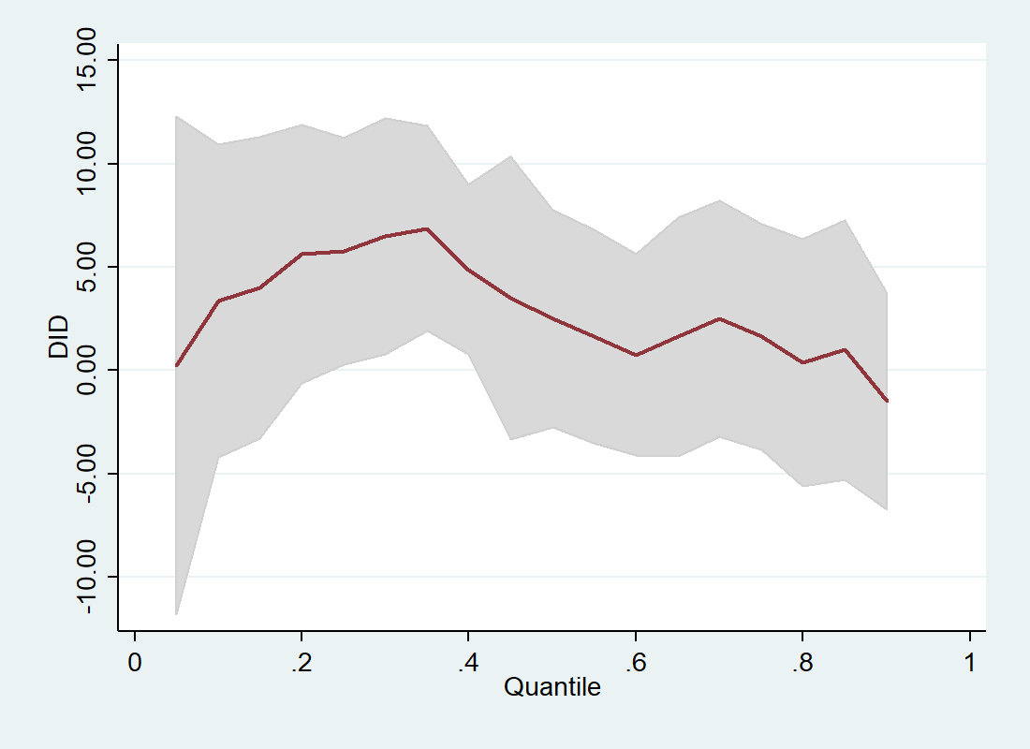
Impact of increasing the dissertation structure on international students

Slide 16
Conclusions
This case study shows that an increase in structure in the UG research project has a positive impact on low performer international students
Implications for departments having the dissertation as a compulsory component of their degree
We expect that there will be benefits on the average quality of the UG dissertation

