Slide 1
Online teaching slides: Are they bane or benefits?
By: Don Webber (UWE)
Linh Nguyen (UWE)
Andrew Mearman (Leeds)
Tim Hinks (UWE)
David Allen (UWE)
Notes:
Our paper focuses on exploring how students choose to engage, virtually with online materials or physically by attending class, to achieve a particular level of academic performance. By analysing the trade-off between the two forms of engagement using isoquants, which is surprisingly underused given its popularity in microeconomics, we’ll be able to see the interaction and how they affect performance.
In other words, we are exploring the production function of academic performance, with the two inputs being these two types of engagement, using the data collected from a microeconomics class. We found that in general, there are two main groups of students: the highly engaged students tend to engage more virtually and physically than the less engaged students, in turn, achieve higher marks. For the highly engaged students, to obtain higher marks, they could keep virtual engagement constant and increase class attendance OR keep attendance constant and reduce virtual engagement. For the less engaged students, increase any of the two form would result in a higher mark.
From our paper, the isoquants map may be of use when introducing students to the concept because at the moment, examples of isoquants aren’t plentiful. Also our paper may help educators to assess the learning style of their audience and tailor your resources to the students’ needs.

Slide 2
What do we know?
Mixed results for the relationship between:
Attendance AND performance
Engagement with online materials AND performance
→ Issue: both attendance and virtual engagement are just proxies for ‘non-cognitive attributes’
Notes:
Given the popularity of VLEs in general in recent years, many studies have attempted to incorporate students’ virtual engagement into their regressions to explain the variation in academic performance. This has led to mixed results probably because it depends on the sample because the impact on grades of virtual engagement depends on a student’s preferred learning style (and perhaps other constraints).
The current literature around this area mainly focuses on determinants of academic performance, with the main focus, in general, on attendance. In terms of results, in general studies with a focus on cognitive factors (e.g. previous grades) would find weak evidence for the impact of attendance and ones with the focus on non-cognitive factors (e.g. independent study time) would find a stronger relationship; access to online materials does not affect attendance in most studies. Regarding performance, again the relationship of online engagement and this is another debate.

Slide 3
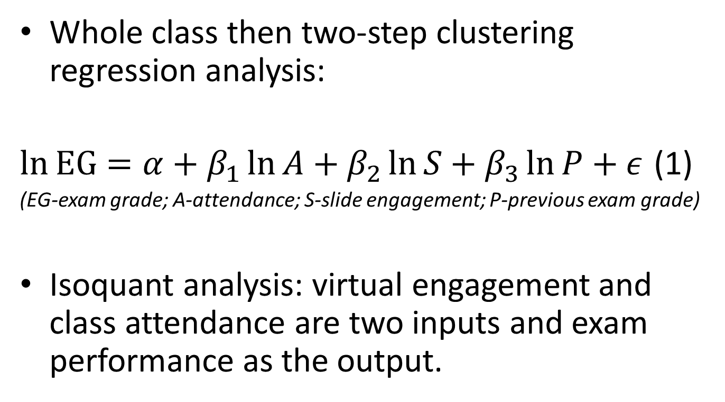
Methodology
Whole class then two-step clustering regression analysis:
$\ln{EG}=α+β_{1}\ln{A}+β_{2}\ln{S}+β_{3}\ln{P}+ε$ (1)
(EG-exam grade; A-attendance; S-slide engagement; P-previous exam grade)
Isoquant analysis: virtual engagement and class attendance are two inputs and exam performance as the output.
Notes:
It is fairly obvious that the evidence from the literature review is not clear cut. Moreover, the lack of consistently significant evidence for lecture attendance begs the question whether this measure is appropriate to use. We suspect that it’s not the attendance itself but the students’ level of engagement when attending, thus, seminar attendance may be a better measure for engagement. The data were collected from level 2 students in a core module, microeconomics. The level of virtual engagement is measured by the time at which each student accessed online materials (with lower score allocated to those who downloaded the files late).
First, we will look at the impact of each medium (to access materials) on students’ performance for the whole cohort, then separate them into two categories: 1.highly engaged students 2. less engaged students; from the regression results we hope to know the strength of each input on these clusters. We’d expect one input would benefit one cluster more than the other. And lastly we’d use the graphical presentation of the isoquant analysis to illustrate the learning style a student could adopt to achieve a particular grade band depending on what group/cluster they will fall into.

Slide 4
Results
Notes:
From the examination of raw data, displayed in this contour, the highly engaged students tend to attend more, engage more with online materials and get better exam marks than the less engaged students. This is expected but if you look at the red areas (i.e. where students achieved a first), one on the far right indicates that students would achieve high marks: 1. if they attend all classes regardless of how engaged they are with online materials 2. engage with online materials to the maximum and attend as little as possible.
Intuitively, this is in line with expectations in the sense that there is a group of highly independent learners who can achieve high marks without attending class regularly. However, for most students who are engaged will probably choose to engage in the traditional method i.e. by turning up (traditional here means habits picked up from school).

Slide 5
Results (cont.)
Notes:
For the less engaged students (purple), with the isoquants are convex to the origin, virtual engagement and attendance are inputs that positively enhance exam grades. For these, the two are complements. For the highly engaged students (blue), the isoquants are concave to the x-axis, thereby suggesting that greater slide engagement is ‘bad’ for the achievement of a higher grade, for more able and more frequently attending students who have slightly greater engagement with slides. In short, for these students, online engagement or attending class can be substitutes. And to obtain higher marks, they could keep virtual engagement constant and increase class attendance OR keep attendance constant and reduce virtual engagement.

Slide 6
Implications
Online materials are beneficial to both groups (highly engaged and less engaged)
Unknown for highly engaged: can they get high marks without VLE?
Highly engaged: more online and maintain attendance → lower grades
Notes:
Overall, online materials would be beneficial for all groups of students. Although online materials can be a substitute for attendance for highly independent learners but these are complementary, to class attendance, for less-engaged students and the more able but prefer to engage physically.
It is uncertain, whether the highly-independent learners would have gained these very high grades in spite of rather than because of the provision of copies of lectures slides using the VLE.
For the highly engaged students in general, to increase virtual engagement whilst keeping attendance constant would decrease their marks probably because of the false sense of security it may create, or the ability to make notes themselves would be undermined in the long run.
The provision of lecture slides may therefore be a simple way to enhance student evaluations and student feedback scores. There may be the need to teach students how to use lecture slides more effectively, for it may not be whether online support enhances performance but whether students use this source effectively. Future research could investigate whether it is attendance or engagement in class that matters, if so, how to measure it. Additionally, further research is also needed to identify whether the results reported here are a reflection of only this sample, which can only be ascertained through replication.

Slide 7
 | Constant | Ln(SlidesMean) | Ln(AttendFrequency) | Ln(L1PrinTestMark) | F | R² | Obs.
All | -1.557 (0.907) | 0.049 (0.095) | 0.165 (0.056)*** | 1.222 (0.219)*** | 16.25*** | 0.267 | 138
1st | 4.221 (0.770)*** | -0.065 (0.038) | 0.038 (0.022) | 0.015 (0.018) | 2.37 | 0.471 | 12
2:1 | 3.807 (0.412)*** | -0.018 (0.020) | 0.037 (0.016)** | 0.066 (0.095) | 2.00 | 0.240 | 23
2:2 | 4.101 (0.188) | 0.014 (0.022) | 0.010 (0.014) | -0.030 (0.046) | 0.45 | 0.044 | 33
3rd | 3.830 (0.371)*** | 0.060 (0.031)* | -0.038 (0.020)* | -0.008 (0.087) | 2.12 | 0.224 | 26
Fail | -4.012 (2.008)* | 0.170 (0.215) | 0.168 (0.124) | 1.726 (0.491)*** | 5.71*** | 0.300 | 44
All cohort
 | Constant | Ln(SlidesMean) | Ln(AttendFrequency) | Ln(L1PrinTestMark) | F | R² | Obs.
Cluster 1 | -3.512 (2.148) | 0.417 (0.288) | 0.129 (0.227) | 1.674 (0.516)*** | 3.99** | 0.218 | 47
Cluster 2 | 0.245 (0.781) | -0.092 (0.064) | 0.158 (0.096) | 0.817 (0.176)*** | 8.68*** | 0.230 | 91
C1: less engaged
C2: more engaged
Notes:
For the cohort’s regression model: Prior ability (previous marks) and attendance are important (for this model, we had expected a weak relationship if any); Clusters: attendance no change but benefits of virtual engagement varies.
For the whole cohort, when combine with data inspection: attendance is beneficial to students in 2:1 band and detrimental to 3rd. Although the coefficients on attendance are insignificantly different between each cluster, the main difference in the regression results correspond to the ability differences and variation in the benefit from engaging with slides.

